Slide 1

7th Grade Math
Unit 11, Lesson 3 Constant of Proportionality – Part 2 Volume 2, pg. 159

Slide 2


Benchmark
MA.7.AR.4.2
Determine the constant of proportionality within a mathematical or real-world context given a table, graph, or written description of a proportional relationship.
volume 2, pg. 159

Slide 3
Integrated Mathematical Thinking and Reasoning Standards
MA.K12.MTR.2.1 Demonstrate understanding by representing problems in multiple ways.
MA.K12.MTR.5.1 Use patterns and structure to help understand and connect mathematical concepts.
MA.K12.MTR.7.1 Apply mathematics to real-world contexts.
volume 2, pg. 159

Slide 4

Learning Targets
I can determine the constant of proportionality from a written description.
I can relate the constant of proportionality to an equation representing a proportional relationship.
volume 2, pg. 159

Slide 5

Warm-Up
volume 2, pg. 160

Slide 6
11.3.1 Warm-Up: Bell Work
The graph represents a proportional relationship.
Describe a situation that could be represented by this graph.
volume 2, pg. 160

Slide 7
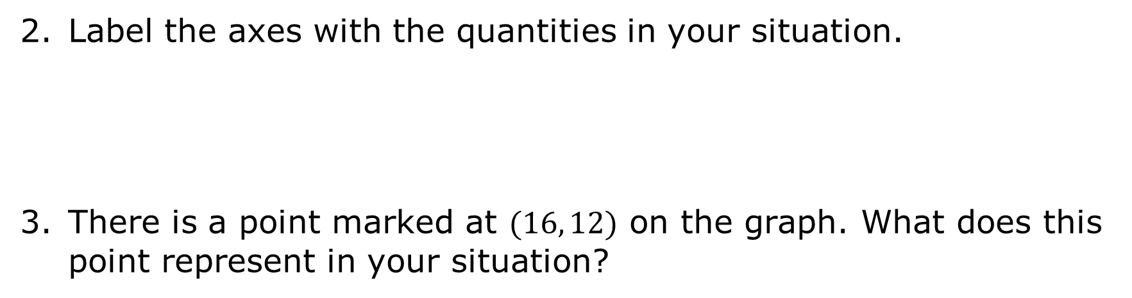
Label the axes with the quantities in your situation.
There is a point marked at $(16, 12)$ on the graph. What does this point represent in your situation?
volume 2, pg. 160

Slide 8

Guided Instruction
volume 2, pg. 160

Slide 9
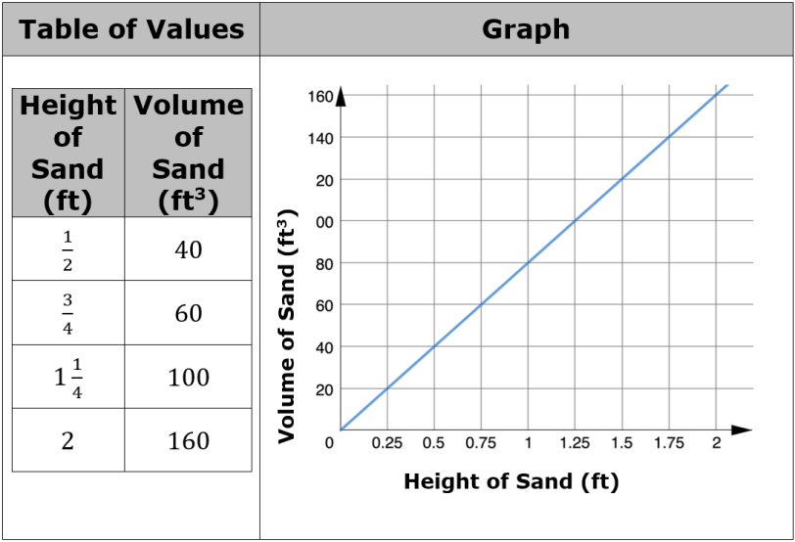
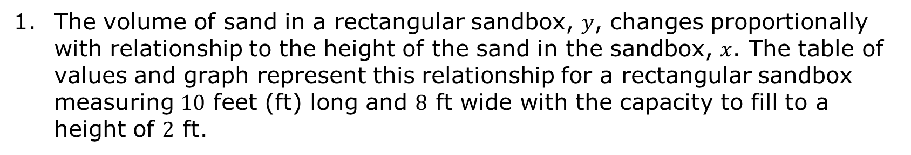
11.3.2 Guided Instruction: Relating the Constant of Proportionality to Written Descriptions
The volume of sand in a rectangular sandbox, $y$, changes proportionally with relationship to the height of the sand in the sandbox, $x$. The table of values and graph represent this relationship for a rectangular sandbox measuring $10$ feet (ft) long and $8$ ft wide with the capacity to fill to a height of $2$ ft.
volume 2, pg. 160

Slide 10

Determine the constant of proportionality, $\frac{y}{x}$, using the table of values. Show your work.
volume 2, pg. 160

Slide 11
Explain how to determine the constant of proportionality using the graph.
Describe the meaning of the constant of proportionality in this context.
The graph of a proportional relationship is shown.
volume 2, pg. 161

Slide 12
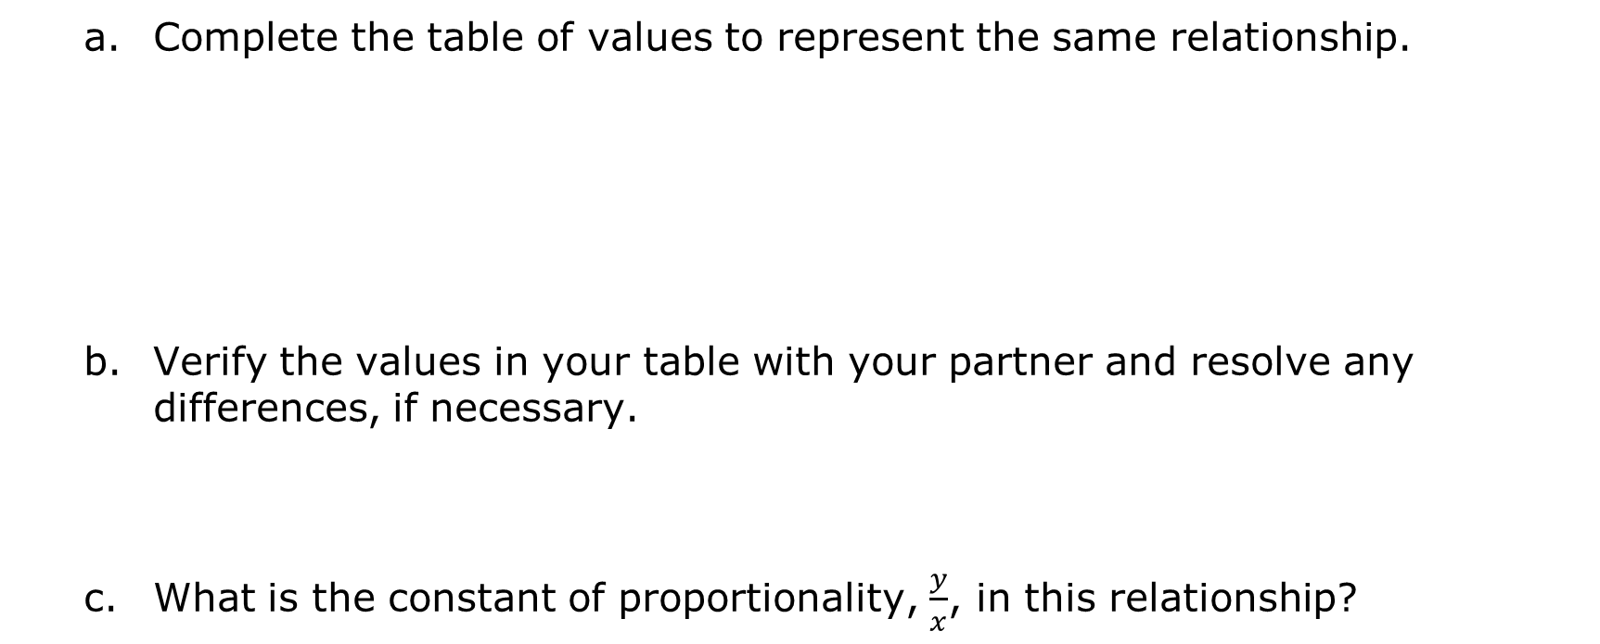
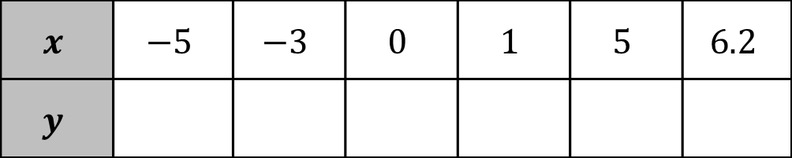
Complete the table of values to represent the same relationship.
Verify the values in your table with your partner and resolve any differences, if necessary.
What is the constant of proportionality, $\frac{y}{x}$, in this relationship?
$$x$$ | $$−5$$ | $$−3$$ | $$0$$ | $$1$$ | $$5$$ | $$6.2$$
$$y$$
volume 2, pg. 161

Slide 13
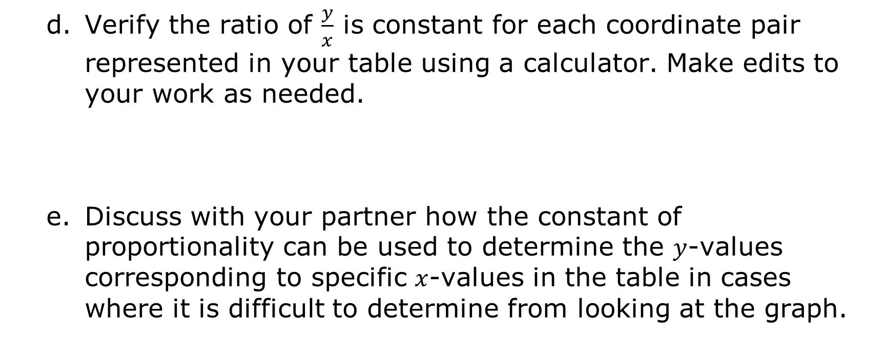
Verify the ratio of $\frac{y}{x}$ is constant for each coordinate pair represented in your table using a calculator. Make edits to your work as needed.
Discuss with your partner how the constant of proportionality can be used to determine the $y$-values corresponding to specific $x$-values in the table in cases where it is difficult to determine from looking at the graph.
volume 2, pg. 161

Slide 14
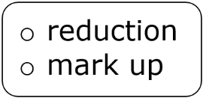
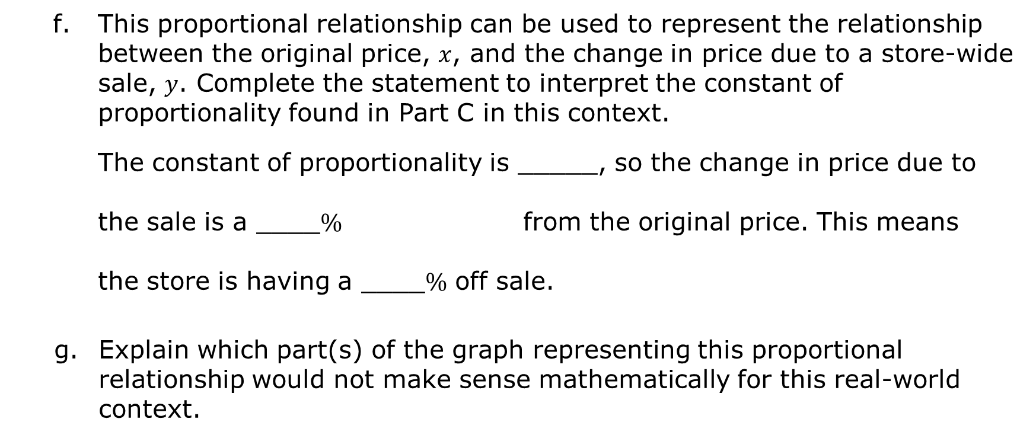
This proportional relationship can be used to represent the relationship between the original price, $x$, and the change in price due to a store-wide sale, $y$. Complete the statement to interpret the constant of proportionality found in Part C in this context.
The constant of proportionality is _____, so the change in price due to the sale is a ____$\%$ from the original price. This means
the store is having a ____$\%$ off sale.
Explain which part(s) of the graph representing this proportional relationship would not make sense mathematically for this real-world context.
volume 2, pg. 162

Slide 15

Guided Practice
volume 2, pg. 162

Slide 16

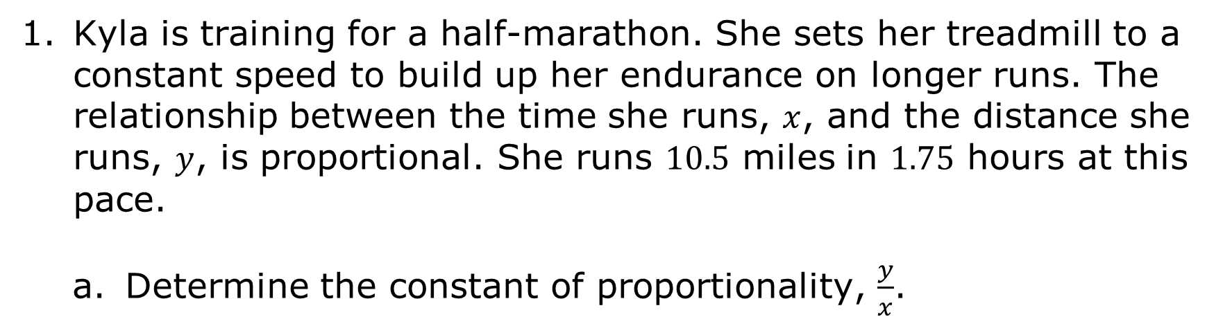
11.3.3 Guided Practice: Determining the constant of Proportionality from a Written Description
Kyla is training for a half-marathon. She sets her treadmill to a constant speed to build up her endurance on longer runs. The relationship between the time she runs, $x$, and the distance she runs, $y$, is proportional. She runs $10.5$ miles in $1.75$ hours at this pace.
Determine the constant of proportionality, $\frac{y}{x}$.
volume 2, pg. 162

Slide 17
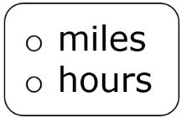
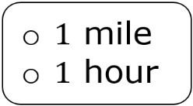

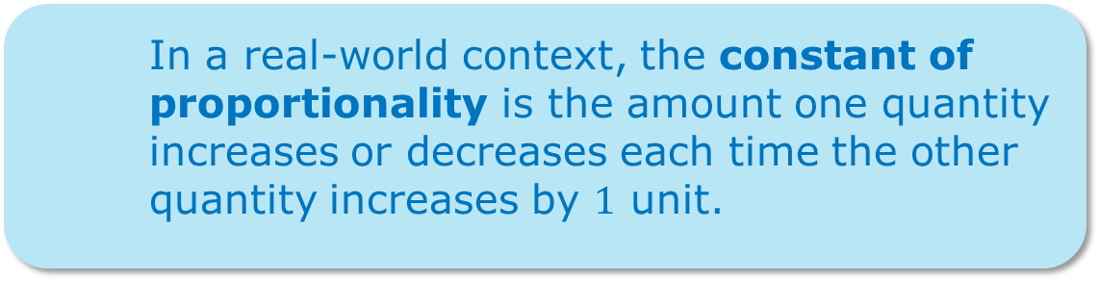
Complete the statement to interpret the constant of proportionality.
At this rate, Kyla runs ______ for every she trains on the treadmill.
In a real-world context, the constant of proportionality is the amount one quantity increases or decreases each time the other quantity increases by $1$ unit.
volume 2, pg. 162

Slide 18

Collaboration
volume 2, pg. 163

Slide 19

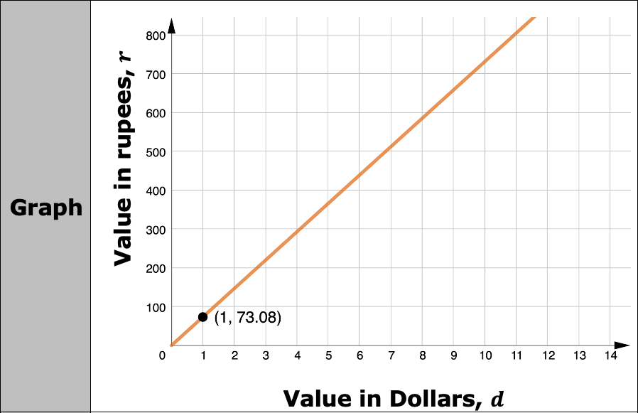

11.3.4 Collaboration: Equations Representing Proportional Relationships
On January 14, 2021, $1$ U.S. dollar was worth $73.08$ Indian rupees. This is a written description of a proportional relationship. Below are two other representations of the same relationship.
volume 2, pg. 163

Slide 20
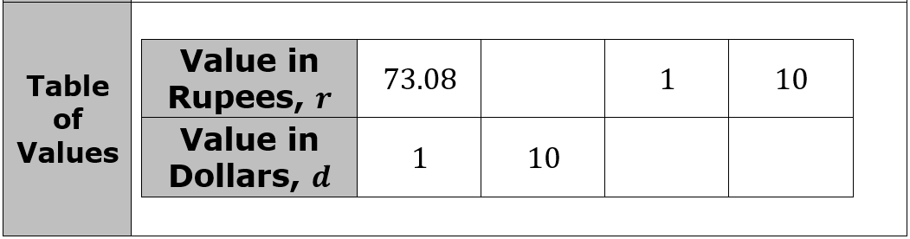
Work with your partner to complete the following.
Complete the table of values by filling in the missing values. Round values to the nearest thousandth, where necessary.
Proportional relationships can also be represented by equations.
volume 2, pg. 163

Slide 21
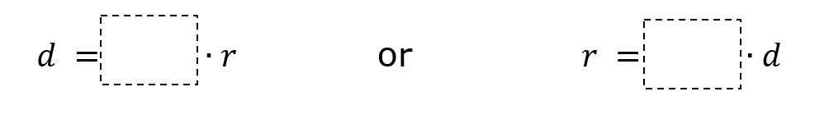
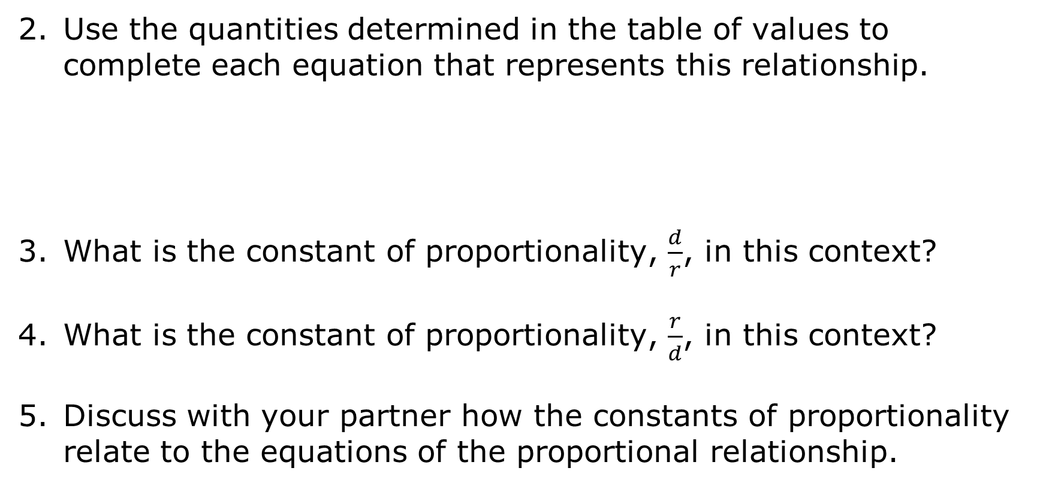
Use the quantities determined in the table of values to complete each equation that represents this relationship.
What is the constant of proportionality, $\frac{d}{r}$, in this context?
What is the constant of proportionality, $\frac{r}{d}$, in this context?
Discuss with your partner how the constants of proportionality relate to the equations of the proportional relationship.
volume 2, pg. 163

Slide 22

Wrap-Up
volume 2, pg. 164

Slide 23
11.3.5 Wrap-Up: Reflection
Color in the arrow up to the statement that best describes your current understanding of the benchmark below.
Determine the constant of proportionality within a mathematical or real-world context given one of these forms: a table, graph, or written description of a proportional relationship.
volume 2, pg. 164

Slide 24
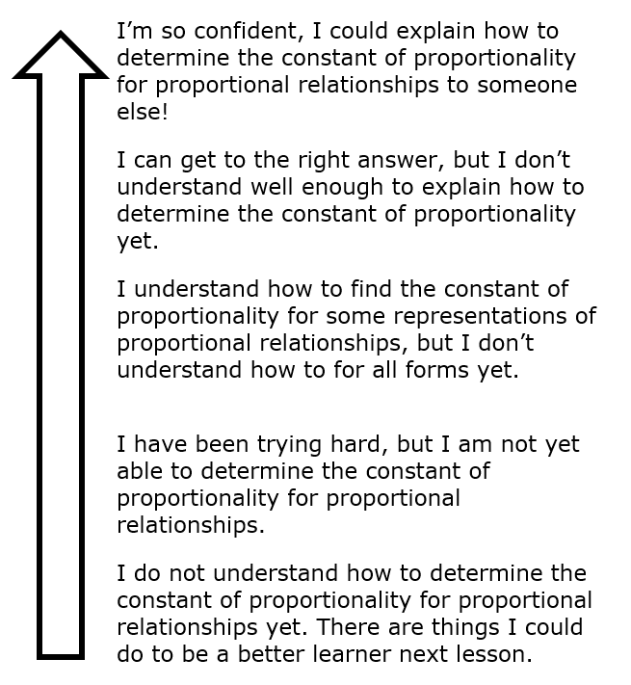
volume 2, pg. 164

